Slide 1
Conversion API Implementation: POC for Meta
02-13-2023

Slide 2
Scope
Out of scope items
Resources required
Deliverables at the end of MVP
Success metrics
Tentative Architecture
Team composition
Skill set required
Estimates
Blockers

Slide 3
Project Conceptualization
01

Slide 4
Scope
Create a system of getting data from client browser, at specific conversion events, and send it to Meta through Conversion API
Store the PII data of the user in a cloud data warehouse
Hash PII data before sending it to Meta through CAPI
Create measures to identify the success rate of calls sent
Create pipelines to extract advertising data from Meta

Slide 5
Out of Scope
A UX platform
Data Security features
Any platform except Meta

Slide 6
Resources
Store the PII data of the user in a cloud data warehouse
Hash PII data before sending it to Meta through CAPI
Create measures to identify the success rate of calls sent
Create pipelines to extract advertising data from Meta

Slide 7
Deliverables
User data for online conversions has to be sent over
Tool should be configurable
There should be extensive documentation for any engineering team to pick up and create the tool if required
Set of challenges
It should have an end to end set up

Slide 8
KPIs
Number of CAPI calls made
Number of call that were successful
Match rate overall, and at different conversion events
Attributable conversion events on FB

Slide 9
Architecture
02

Slide 10





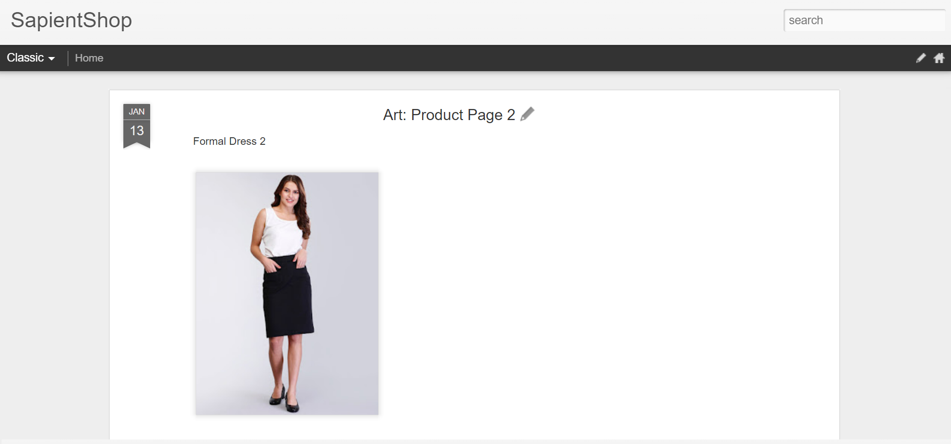





Architecture
Calls Node JS function in App Engine
4
Event in pub/sub queue
Node JS function calls CAPI
2
3
Javascript snippet ingested on browser
Conversion even information along with hashed user information send to Meta
All events queued within Pub/Sub along with event and user information
User and event information stored within BQ
Javascript snippet fired on select conversion events, calls Node JS function through AJAX
5 B
1
User data to FB
5 A
FB Data stored within BQ
6
User information and event data
8
7
FB Data extracted from Ad reports
9
FB Reports:
Match rate
Attributable conversions
Reports to measure success of platform, process and marketing strategies
KPIs to measure success
Datasets can be merged to measure marketing performance accurately, and design targeted campaigns

Slide 11
Resourcing
03

Slide 12
Team Composition
CAPI Implementation (8 weeks)
Delivery Lead
Data Engineer (100%)
Data Analyst (100%)
Program Manager (25%)

Slide 13
Skills
Backend: Java
Frontend: HTML, Javascript
Cloud Platform: GCP
Technologies: BgQuery, Custom Functions, DataFlow, Pub/Sub, APIs, Data Modeling, Data Studio
Deployment: Preferably in containerized environment

Slide 14
What we need?
04

Slide 15
Blockers
Need access to Meta advertising account
Need access to the business manager account
Need to have ads on Meta for the client
Need to send user information to clients when they click on the Meta advertisement

Slide 16
Estimates
MVP Delivery
Duration (Weeks) | 8
Role | Level | # | Geo | Rate | Days | Cost
Product lead | Director | 0 | India |  | 40 | $ -
Engineering lead | Director | 0 | India |  | 40 | $ -
Senior architect | Snr Mgr | 1 | India |  | 40 | $ -
Architect | Snr Asc | 0 | India |  | 40 | $ -
Data engineer | Snr Asc | 2 | India |  | 40 | $ -
Data analytics | Snr Asc | 1 | India |  | 40 | $ -
DevOps | Snr Asc | 0 | India |  | 40 | $ -
Scrum master | Snr Asc | 0.25 | India |  | 40 | $ -
Overall |  | 4.25 |  | $ - | 320 | $ -

Slide 17
Thanks!

